Slide 1
ParkEase – Smart Parking Management Platform
TEAM NO. 17
TEAM MEMBERS
• Panuganti Rajesh – 99230040711
• Yepuri Rohith – 99230040464
• Badineni VenuGopalaRao – 99230040483
• Mannam Chaithanya Kumar – 99230040659
• MademReddy Maheshwar Reddy – 99230040361

Slide 2
PROBLEM STATEMENT
• Drivers often reach parking facilities without knowing whether spaces are available.
• Searching for an empty parking space can waste time and increase traffic congestion.
• Drivers may not know the parking charges in advance for their vehicle and duration.
• Manual entry and exit procedures can create delays at parking gates.
• Parking operators need a simple way to manage spaces, reservations, and occupancy.
PARKEASE | TEAM 17
02 / 12

Slide 3
OBJECTIVES
• To provide an online platform for discovering parking facilities.
• To display facility details, available spaces, and parking amenities.
• To allow drivers to select a specific parking slot and make reservations.
• To show estimated parking charges based on vehicle type and duration.
• To help operators manage parking facilities, slots, and gate operations.
• To provide administrators with user management and usage analytics.
PARKEASE | TEAM 17
03 / 12

Slide 4
PROPOSED SYSTEM
• ParkEase provides an online smart parking management platform.
• Drivers can search for parking facilities, view details, and check slot availability.
• Drivers can select a parking bay, estimate the cost, and confirm a reservation.
• The system generates a digital booking reference and simulated QR pass.
• Parking operators can manage facilities, slots, and simulated gate entry and exit.
• Administrators can manage users, review reservations, and view platform analytics.
PARKEASE | TEAM 17
04 / 12

Slide 5
PROPOSED METHODOLOGY
• Driver opens the ParkEase website and enters the driver portal.
• Driver searches for a parking facility and checks its details and availability.
• Driver selects an available slot and chooses the vehicle type and parking duration.
• System calculates the estimated parking charge and confirms the reservation.
• A unique booking reference and simulated QR pass are generated.
• Operator verifies the booking at the gate and marks the slot as occupied.
• Driver tracks the active parking session; operator checks out the vehicle and the system calculates the final duration and fee.
PARKEASE | TEAM 17
05 / 12

Slide 6
FUNCTIONALITIES
DRIVER MODULE
PARKING OPERATOR MODULE
ADMIN MODULE
• Facility search and filters
• Map-based facility discovery
• Facility comparison and cost calculator
• Interactive slot selection
• Reservation and digital booking pass
• Active session timer and fee display
• Vehicle management, favorites, and notifications
• Booking cancellation / unreserve
• Operator dashboard and occupancy view
• Facility creation and configuration
• Slot inventory generation
• Maintenance status for parking bays
• Gate entry pass verification simulation
• Vehicle registration lookup
• Checkout duration and digital receipt
• Admin dashboard and platform metrics
• User directory and role management
• Reservation audit view
• Facility and slot management
• Usage analytics and charts
• Database reset and sample-data reseeding
PARKEASE | TEAM 17
06 / 12

Slide 7
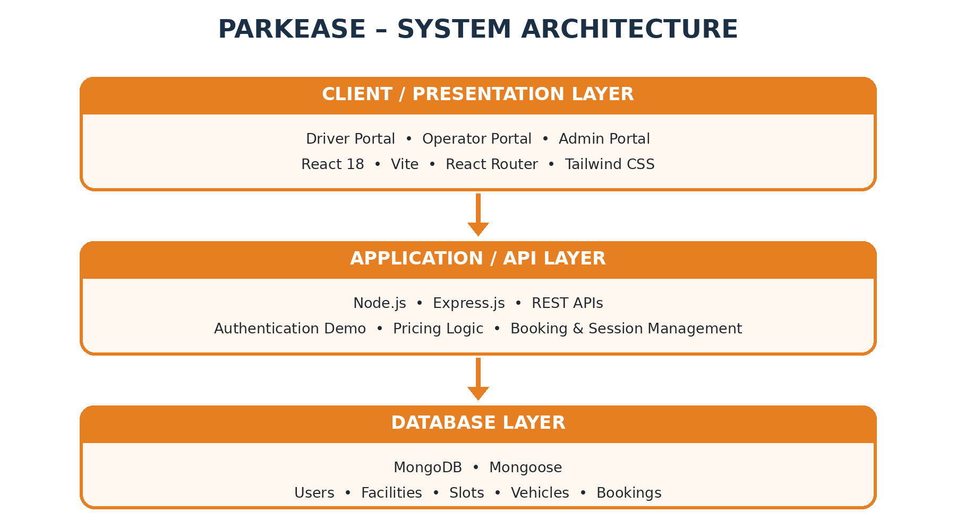
SYSTEM ARCHITECTURE

Slide 8
DATABASE COLLECTIONS
• Users Collection – Stores user profile, contact, and role information.
• Facilities Collection – Stores parking facility details, location, capacity, and pricing settings.
• Slots Collection – Stores individual parking bay identifiers, type, and availability status.
• Vehicles Collection – Stores driver vehicle information and vehicle category.
• Bookings Collection – Stores reservation details, booking reference, selected slot, and session status.
PARKEASE | TEAM 17
08 / 12

Slide 9
TECHNOLOGIES USED
• React 18 – Builds the user interface for drivers, parking operators, and administrators.
• Vite – Runs the frontend development server and provides fast build and reload support.
• Tailwind CSS – Styles the pages, dashboards, forms, buttons, and responsive layouts.
• React Router – Handles navigation between public pages and the driver, operator, and admin portals.
• Node.js – Runs the JavaScript backend server.
• Express.js – Provides REST API routes for facilities, slots, vehicles, bookings, and user operations.
• MongoDB – Stores user, facility, slot, vehicle, and booking data.
• Mongoose – Defines database models and helps the backend read and update MongoDB records.
• Leaflet + OpenStreetMap – Displays parking facility locations on an interactive map.
• Recharts – Displays dashboard charts such as reservation activity and parking capacity.
• Axios – Sends HTTP requests from the React frontend to the backend APIs.
• Context API + Lucide React – Shares app state such as demo identity/notifications and displays interface icons.

Slide 10
ADVANTAGES
• Saves Time: Drivers can check parking facilities before arriving.
• Better Visibility: Facility details and slot status are available in one place.
• Transparent Pricing: Estimated charges are shown before a reservation is confirmed.
• Organized Operations: Operators can manage facilities, slots, and maintenance status.
• Digital Workflow: Booking references and simulated gate verification reduce paper-based steps.
• Centralized Monitoring: Administrators can review users, reservations, and usage analytics.
PARKEASE | TEAM 17
10 / 12

Slide 11
CONCLUSION
ParkEase is a MERN-based smart parking platform that helps drivers find parking spaces, check availability, estimate charges, and make reservations. It also helps operators manage parking facilities and administrators monitor the system. The platform reduces manual work, saves time, and makes parking management more efficient and convenient.

Slide 12


